Slide 1
Multi-Pointer Co-Attention Networks for Recommendation
Advisor: Jia-Ling, Koh
Source: KDD 2018
Speaker: Shao-wei, Huang
Date: 2019/04/15

Slide 2
Outline
Introduction
Method
Experiment
Conclusion

Slide 3
Introduction
Item recommendate for user.
Recommedate
Recommedate
Score = ???
Score = ???
Only take a (user, item)pair at a time.

Slide 4
Introduction
Input
User reviews （all reviews he(she) has reviews）.
Item reviews （all reviews that was written for it）.
Output
A scalar, representing the strength of the user-item interaction.

Slide 5
Introduction
Defects of traditional recommendation
Concatenation all reviews is unnatural and noisy.
Defects of traditional recommendation
User and item representations are static irregardless of the target match.
Compress large user-item review banks into low dimensional vector representations
MPCN
Multi-Pointer Co-attention Networks

Slide 6
FRAMEWORK
6
Word-level Representation
Row/Col Avg Pooling
Review-level Representation

Slide 7
FRAMEWORK
6
Word-level Representation
Row/Col Avg Pooling
Review-level Representation

Slide 8
FRAMEWORK
6
Word-level Representation
Row/Col Avg Pooling
Review-level Representation

Slide 9
FRAMEWORK
6
Word-level Representation
Row/Col Avg Pooling
Review-level Representation

Slide 10
FRAMEWORK
6
Word-level Representation
Row/Col Avg Pooling
Review-level Representation

Slide 11
FRAMEWORK
6
Word-level Representation
Row/Col Avg Pooling
Review-level Representation

Slide 12
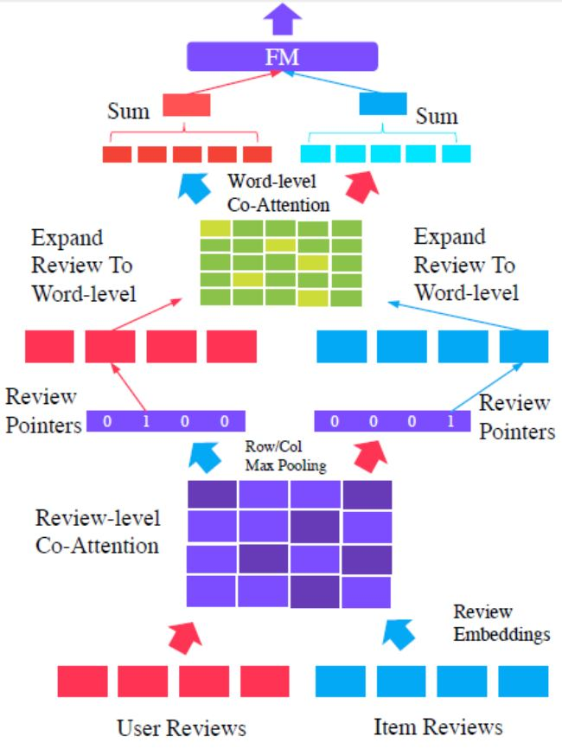
FRAMEWORK
6
Word-level Representation
Row/Col Avg Pooling
Review-level Representation

Slide 13
Outline
Introduction
Method
Experiment
Conclusion

Slide 14
Method
Input Encoding
Each review is represented as a sum
of its constituent word embeddings
to form the vector $x_{i}$ ∈ $R^{d}$.
First-stage filter：
T
T
d*d
d*1
d*1
d*d
d*1
d*1
Whether to pass this review or not
How much information will be passed down

Slide 15
Method
Review-level Co-Attention
Calculate an affinity matrix：
F(.) is a feed-forward neural function
with l layers.
Item
review3
Item
review1
Item
review2
Item
review3
Item
review4
Item
review1
Item
review2
Item
review4
1*d
d*d
d*1
3 | 6 | 1 | 4
4 | 7 | 8 | 8
5 | 2 | 1 | 2
3 | 4 | 3 | 9
User
review1
3 | 6 | 1 | 4
4 | 7 | 8 | 8
5 | 2 | 1 | 2
3 | 4 | 3 | 9
User
review1
User
review2
User
review2
Item review → Column Max pooling.
User review → Row Max pooling
5 | 7 | 8 | 9
User
review3
User
review3
User
review4
User
review4

Slide 16
Method
Review Pointers
Use Gumbel-softmax to replace Softmax.
Forward-pass：converting the vector output to a one-hot vector.
Backward pass：maintains the flow of continuous in order to train the model.
Review-level Representation
Gumbel
softmax
One
hot
5 | 7 | 8 | 9
0.01 | 0.03 | 0.06 | 0.9
0 | 0 | 0 | 1

Slide 17
Method
Review Pointers
Review-level representation：
d dimension
Review-level Representation
User Review1 embedding
*
Item Review2 embedding
0 | 0 | 0 | 1
Item Review3 embedding
Item Review4 embedding
=
Formula：

Slide 18
Method
Word-level Co-Attention
Calculate an affinity matrix：
Item
Review W3
Item
Review W1
Item
Review W3
Item
Review W4
Item
Review W1
Item
Review W2
Item
Review W4
Item
Review W2
User review → Column Avg pooling.
Item review → Row Avg pooling
3 | 6 | 1 | 4
4 | 7 | 7 | 8
5 | 2 | 1 | 2
3 | 4 | 3 | 9
User
Review W1
3 | 6 | 1 | 4
4 | 7 | 7 | 8
5 | 2 | 1 | 2
3 | 4 | 3 | 9
User
Review W1
User
Review W2
User
Review W2
3.75 | 4.75 | 3 | 5.75
User
Review W3
User
Review W3
User
Review W4
User
Review W4

Slide 19
Method
Word-level Co-Attention
Softmax：
Softmax
3.75 | 4.75 | 3 | 5.75
0.22 | 0.28 | 0.17 | 0.33
Word-level representation：
Formula：
d dimension
User Review W1 embedding
0.22 | 0.28 | 0.17 | 0.33
*
User Review W2 embedding
User Review W3 embedding
User Review W4 embedding
=

Slide 20
Method
Multi-Pointer Learning
Runs the Review-level Co-Attention $n_{p}$ times, with each generating a unique pointer.
From ${\overline{a′}}_{1},{\overline{a′}}_{2}… to{ \overline{a′}}_{n_{p}}$
From ${\overline{b′}}_{1},{\overline{b′}}_{2}…to{ \overline{b′}}_{n_{p}}$
Word-level Representation
Word-level Representation
**One pointer can only receive “one” word level
representation.
Review-level Representation
Review-level Representation
Runs $n_{p}$ times
Notes:
Description the ways of the sum at the same time.

Slide 21
Method
Prediction layer
Word-level Representation
$a_{f}$ and $b_{f}$ are the result of sum all of the
word-level representations.
Concatenation
Additive composition
Nerual network
Notes:
However, how to correspond to 1-D representation.

Slide 22
Method
Prediction layer
Word-level Representation
X = [$a_{f}$ ; $b_{f}$ ]
Formula：
$v_{i }$ dot $v_{j }$, the similarity between i andj
$v_{1 }$ $v_{2 } v_{3 }$……………….. $v_{n}$
Matrix factorization：
$x_{1 }$ $x_{2 } x_{3 }$……………….. $x_{n}$
$c_{1 }$ $c_{2 } c_{3 }$ ….. $c_{k}$
*
X：
1*n
1*k
k*n
Notes:
However, how to correspond to 1-D representation.

Slide 23
Outline
Introduction
Method
Experiment
Conclusion

Slide 24
EXPERIMENT
Dataset
Yelp:
Yelp is an online review platform for businesses such as restaurants, bars, spas, etc.
Use 20-core fashion.
Amazon:
A well-known Ecommerce platform. Use 23 datasets from the Amazon
Product Review corpus
Use a 5-core fashion.

Slide 25
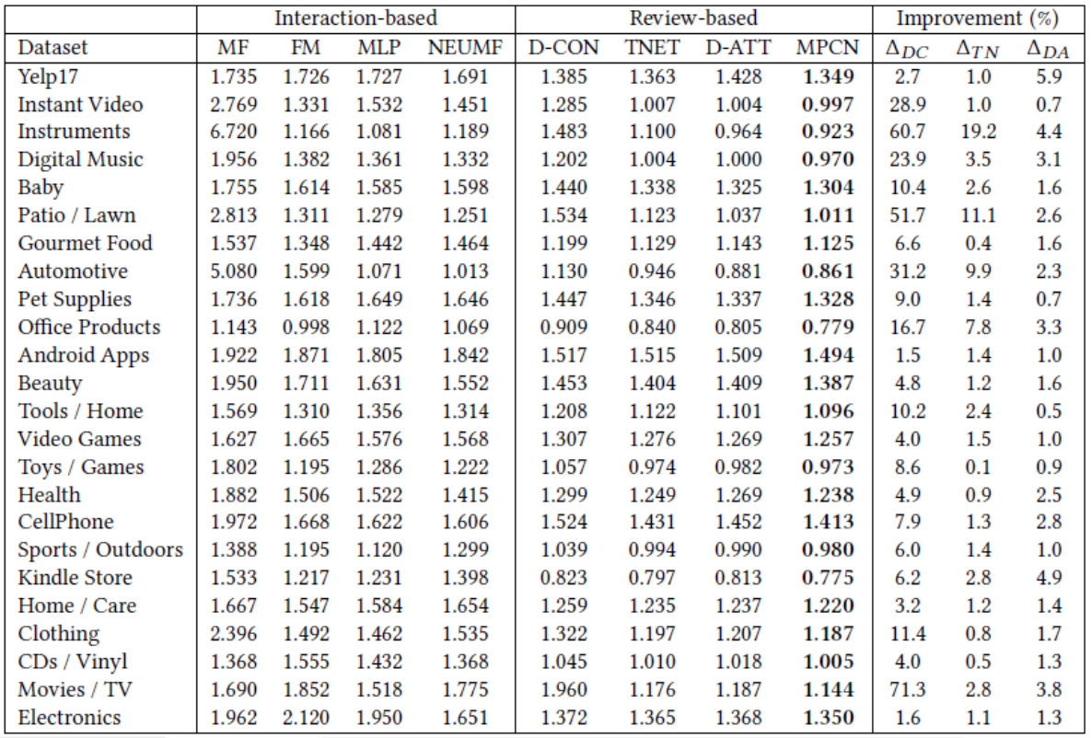
EXPERIMENT

Slide 26
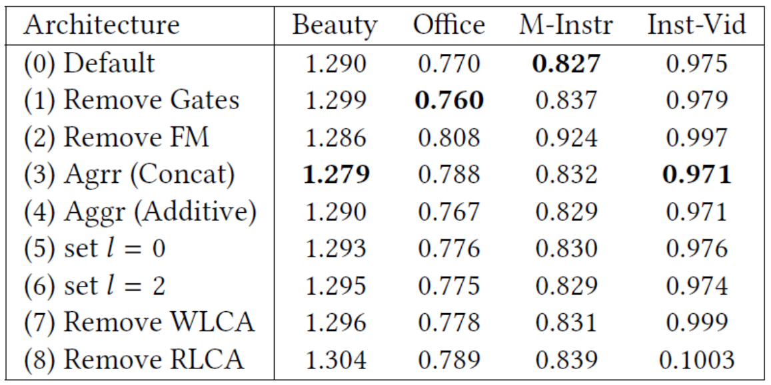
EXPERIMENT
Validation Mean squared error
Various architectural choices on model performance.

Slide 27
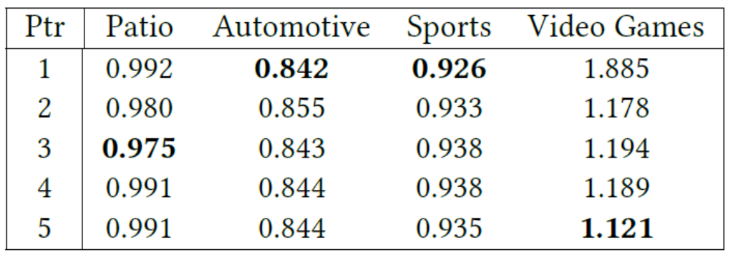
EXPERIMENT
The effect of varying pointers on performance.
**Domain-dependent

Slide 28
EXPERIMENT
Validation Mean squared error
What are the pointers pointing to?

Slide 29
EXPERIMENT
Observe if multi-pointers are really necessary.
Analysis of Multi-Pointer Behavior of MPCN on five datasets using $n_{p}$ = 3

Slide 30
Outline
Introduction
Method
Experiment
Conclusion

Slide 31
Conclusion
Proposed a new state-of-the-art neural model for recommendation.
Our proposed Multi-Pointer Co-Attention Networks outperforms many strong competitors on 24 benchmark datasets from Amazon and Yelp.
By analyzing the pointer behavior across multiple domains, we conclude that the result are domain dependent.

